Slide 1
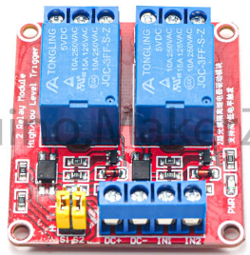
GPIO25 to Switch
ESP32
W5500
GND
GND to GND
GPIO23 to MOSI
GPIO26 to IN1
GPIO19 to MISO
GND to GND
GPIO18 to SCLK
RAW to VCC
GPIO5 to SCS
RAW to 5V

